Slide 1
File Systems
Review of File Systems and Disk Management

Slide 2
File System Functions
Disk Management: allocate disk blocks to files
Naming (device independence): how to map user file names into physical addresses
Protection: security and sharing of files, as needed
Reliability: protection against crashes
disk crash loses permanent info on disk;
system crash can lose info in kernel buffers that hasn't been written to disk yet.
Performance/Efficiency: try to reduce amount of time spent in I/O

Slide 3
Files and (Magnetic) Disks
The disk is composed of sectors, tracks, surfaces, cylinders – this is the physical view of secondary storage
The OS maintains a file system to hide messy disk details from applications.
The file system provides an abstract view of the disk as a collection of logical blocks instead of sectors.

Slide 4

from Operating Sytems, by William Stallings, Prentice Hall

Slide 5
Files and Disks
A sector is the physical unit of data transfer between memory and disk; a block is the logical unit of data transfer, as managed by the file system. A block is a sector multiple. (UNIX block size = 4-8KB, usually)
The user views a file as a sequential stream of bytes (in UNIX and similar systems) or as a collection of fields/records (in database systems).
When the user program reads or writes data the file system will fetch/write the block that contains those bytes.

Slide 6
Common Access Methods
Sequential access: get_next
Most file systems support this. For example, a C++ program will always maintain a pointer to the next byte to be read (or written) in an open file
Random or direct access: seek to a particular location in the file – may be identified by byte or record number or some field value (in indexed files).

Slide 7
Performance Efficiency
Caching and buffering
Minimize storage fragmentation – small, unusable blocks of free disk space
Minimize file fragmentation, splitting a file into multiple blocks so that a seek may occur between any two blocks
  Objective: optimize locality – store related information close together

Slide 8
File System Caching
The disk cache is a set of blocks (buffers) that are set aside in kernel space. Copies of recently accessed file blocks are kept here to reduce the number of disk accesses
Same concept as cache memory, which reduces the number of main memory references.
Blocks in the disk cache may be file data, or file system metadata (i-nodes, directory blocks, etc.)

Slide 9
The memory hierarchy
Various levels of
hardware caches
Main
Memory
Disk Cache
Disk Storage

Slide 10
Buffering in the File System
Buffers are temporary storage located between a process and the disk.
Buffered input: Read one or more blocks from disk to memory – return to user as requested.
For sequential reading, buffering can (ideally) keep ahead of the user process, reducing the number of delays to wait for input.
Buffered output: Save writes until a full block has been written, then dump to disk.

Slide 11
Caching and Buffering
Buffering and caching have somewhat different purposes, but both reduce disk accesses, improve execution performance.
The same kernel memory locations can serve both purposes (buffers or caches).

Slide 12
File System Data Structures
Free-space list: represents the free disk blocks. May be stored as a bit map.
File mapping structure used to associate file blocks with disk blocks (where is the file stored?)
  File Allocation Tables (FAT)
  indexed structures (e.g. UNIX inodes)

Slide 13
Disk Allocation Techniques
Contiguous
Linked
Indexed

Slide 14
Contiguous Allocation
Allocate disk space as a set of contiguous blocks (sequential)
File map structure has address of first block, number of blocks
Advantage: fast access (both sequential and random)
Disadvantages: fragmented disk space; problems when file grows

Slide 15
Linked Allocation
Allocated disk blocks may be anywhere on disk.
File map contains address of first block; subsequent links stored directly in the blocks (block 0 contains the address of block 1, block 1 contains address of block 2, etc.)
Advantages:
  file can grow dynamically so no disk fragmentation;
  sequential access is reasonable (requires a seek between blocks which isn’t needed in contiguous) but not as good as for contiguous allocation.
Disadvantages: random access is impractical -

Slide 16
Indexed
Allocation is similar to linked methods:
  Allocate space as file grows, in some fixed block size
  Allocation unit = one or more sectors
Each process has its own file map (or index): a block of pointers to the individual blocks of the file – similar to a page table.
Sequential and random access take roughly the same amount of time.

Slide 17
Indexed – Evaluation
Disk utilization is good, no fragmentation
May require a separate seek for each block, so access times are slower than for sequential allocation (but faster than for linked allocation).
Usual approach: try to store file blocks sequentially if possible, but use index for access.
The UNIX inode structure is an example of a multilevel index.

Slide 18
Disk Access
A disk access has three components:
  Seek: locates the cylinder (track)
  Rotational delay: locates the sector
  Transfer: transfer data btw. memory and disk
Seek: most time-consuming factor
  data transfer times are less significant.
Moving large amounts of data in a single operation reduces the seek overhead.

Slide 19
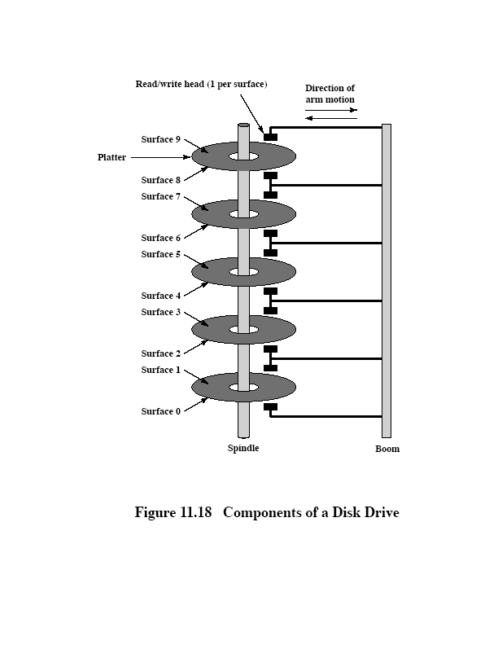

Slide 20
Disk Scheduling
Disk scheduling algorithms optimize throughput by reducing the total seek time needed to satisfy a set of requests.
Useful primarily in server systems or other environments where request queues develop
  SSTF: shortest seek time first.
  SCAN: similar to SSTF, but works on the principle of an elevator: head moves in one direction only.
Otherwise, FIFO is sufficient

Slide 21
File System Case Study
UNIX FFS
Read Sections 1, 2, 3
Skim 3.1, 3.2, 3.3

Slide 22
References
UNIX Internals, the New Frontiers, Uresh Vahalia, Prentice Hall, 1996.
"A Fast File System for UNIX," Marshall Kirk McKusick, William N. Joy, Samuel J. Leffler, Robert S. Fabry, ACM Transactions on Computer Systems, vol. 2, (Aug. 1984).

Slide 23
Outline
UNIX file system – versions
Characteristics of UNIX-like systems
Evolution of UFS
  Early ufs – problems
  Berkeley Fast File System (FFS or BSD/FFS)

Slide 24
UNIX-like File Systems
There are two main versions of the UNIX file system: s5fs [system V file system) and UFS [UNIX file system]. UFS is sometimes called FFS (Berkley Fast File System) because it was developed there originally.
File systems for FreeBSD, Solaris, OpenBSD, etc. are UFS/FFS derivatives.
Linux file system is modeled after UFS.

Slide 25
Characteristics of UNIX-like File Systems
File Storage/inodes
File Sharing/locking
File I/O

Slide 26
UNIX File Storage
UNIX files are stored non-contiguously.
Each file is represented by an inode, a data structure which resides on disk.
An inode table holds a block of inodes
File system directory stores file names; resolve to inode numbers which are pointers into the table.
  Resolution may be done via hashing
File metadata is stored in the inode.

Slide 27
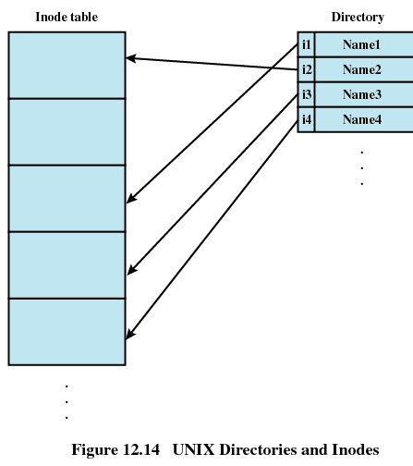

Slide 28
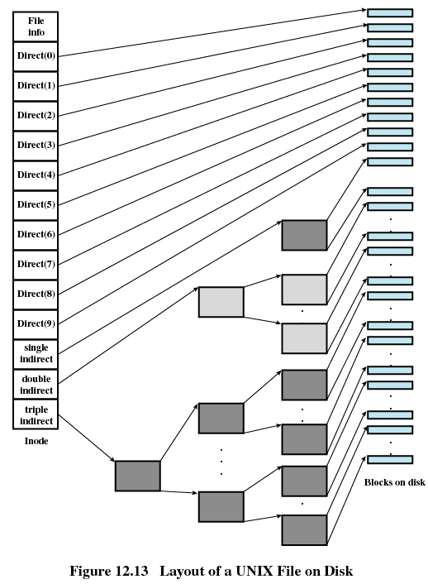
Source: Operating Systems by William Stallings

Slide 29
UNIX File Sharing
UNIX permits users to share a file.
Multiple concurrent accesses are possible. If two I/O operations start at about the same time, serial access is enforced to make sure data is consistent. That is, one operation is performed in its entirety before the next one begins.
However, a read from user 1, followed by a write from user 2, followed by a read from user 1 means that user 1 is reading two different versions of the file. UNIX provides various file locking mechanisms to be used if this is a problem (advisory, mandatory, …)

Slide 30
File Locks, in UNIX
No standard locking scheme.
Most systems provide advisory locks:
  Cooperating processes can agree to use the locks, but if one process breaks the agreement, there’s no penalty
Mandatory locks are provided by some UNIX systems, but advisory is the default.
Locks can be shared or exclusive (read or write), and may be applied to the whole file or a segment of it.

Slide 31
File I/O - Read
For reads, if the data is already in memory (in a buffer) it is transferred to the user's space. The user is not blocked.
If not, the reader blocks (sleeps) until the data is available.
The read operation is said to be synchronous.

Slide 32
File I/O - Write
Writes go to memory buffers and are transferred to disk later. Considered synchronous, but aren’t.
  output operations can be scheduled according to some performance heuristic.
  A write may change the size of a file. Before data is written to disk, the file system may need to allocate new blocks.
If a write changes part of a block, the system must read in the entire block, make the changes, write entire block back to disk.

Slide 33
Evolution of UNIX File System
Early versions
  Disk layout
  Limitations
Berkeley FFS

Slide 34
Berkeley Fast File System
Improved performance and added features, compared to earlier versions of the UNIX file system.
Improvements
  Reliability
  Performance enhancement (faster)
  Usability features

Slide 35
Disk Format in Early UFS
The superblock contains metadata about the system: size, # of tracks, location of inodes, free block list, etc. Corruption of this area compromises the entire system. Reliability is a problem.
UNIX disk structure/early versions
Boot
Block
Superblock
inodes
Data blocks

Slide 36
Performance Limitations
inodes were located in one area of the disk, data blocks elsewhere. This means a lot of time spent seeking:
  read inode, seek to appropriate data block.
Originally, disk blocks are put on the free-space list in order, but as files are changed or deleted blocks are returned to the list in a random order.
No attempt is made to allocate blocks contiguously; just get them directly off free list.
Eventually blocks are allocated to files randomly. This adversely affects sequential processing.

Slide 37
Summary:Limitations of Early UNIX File Systems
Performance Limitations
  Separation of inodes from data blocks
  Files not stored contiguously
  Small block size
Reliability
  Corruption of superblock
Useabilitiy
  Short file names

Slide 38
Berkeley FFS Enhancements
Cylinder groups
Increased block size
Other features

Slide 39
FFS Enhancements
Two of the changes were designed to make file operations more efficient either by reducing the number or length of seeks.
  Large block size
  Cylinder groups
Another change - Long File Names - improved usability
Replication of superblock improved reliability.

Slide 40
Other functional enhancements
Introduced
  Locking mechanisms (advisory)
  Symbolic links: support file sharing between different physical file systems.
    A special file that contains a pathname which names another file

Slide 41
Cylinder Groups
Consist of a set of consecutive cylinders.
For reliability, each cylinder group has a copy of the superblock. The superblock is stored in a different position on each cylinder group, so damage to one surface won’t ruin all copies of the superblock.
For performance, the cylinder group contains related information (e.g., inodes and the data blocks they reference) to reduce seek times.

Slide 42
Increased Block Size
Allowed more data to be moved in a single operation. Block sizes ranged from 4K to 8K.
Using a block size of 4K, files up to 2³² bytes can be addressed with only two levels of indirection.
Today, the default block size for a freeBSD file is 16K

Slide 43
Storage Allocation
To accommodate small files and avoid wasted space, large disk blocks can be divided into fragments, which are allocated separately. Fragment size can be any power-of-two fraction of total block size (down to 512 bytes).
A fragmented block can store the last portions (partial blocks) of several files.

Slide 44
Disk Space Allocation
Done in response to a write system call. There are three possibilities:
If the current file does not fill the last block or fragment, and there is enough room to write new data in the existing space no additional space is allocated.
If the last block doesn't contain enough space for the new data, look for one or more contiguous fragments.
  If the amount to be written is a block or more, allocate one or more new blocks as needed.
If the file has fragments, and the fragments plus the new data will fill a block, then copy fragments plus new data into a newly allocated block.

Slide 45
Placement Issues
Placement considerations (most are designed to take advantage of locality):
  Try to place all inodes for the files in a single directory in the same cylinder group.
  Try to place data blocks in the same cylinder group with their inode
  Try to place all blocks in a file close together to support sequential reads. Consider rotational characteristics of the disk.

Slide 46
Performance
Studies showed that FFS performed substantially better than s5fs, particularly on read operations.

Slide 47
Questions
How do file systems take advantage of the principle of locality?
How do fragmentation issues compare in main memory management and disk memory management?
Can you see comparisons between paged virtual memory management and indexed disk allocation policies?

Slide 48
Files and Disks
Standard sector size has been 512 bytes, although some disks had larger sectors.
  4K byte sectors became a standard in 2011.
Traditionally, every sector has had the same # of bits, even though the physical sector side gets larger as you move from center to edge.
Zoned recording divides disk into groups of adjacent tracks and stores more data in large zones than in small ones.

Slide 49
